Slide 1

Special Notes
Dear colleagues,
You know that a sentences may be completed in different ways, So to realize the main theme, students will be asked to write the question on the answer script and then they will complete the rest part. Completed part must be underlined. Only answer should not be written in the answer script. It is a matter of remember that after completing the sentence , it will express a complete event of topic to mean it contextual. Necessary notes are given below the slide .
Your near and dear
Komal Kanta Ray Talukder
L.P.High School & College
Chhatak,Sunamgonj.

Slide 2


Welcome
Notes:
Welcome slide.

Slide 3

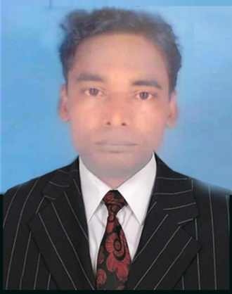
Introduction
Komal Kanta Ray Talukder
Lecturer L.P.High School & College
Chhatak,Sunamgonj.
Presentation made for
Class IX-X
English 2nd paper
Grammar
Notes:
Introduction of the teacher and the class.

Slide 4

We eat so that__________
we can live.
What are we going to discuss today?
Completing sentence
Notes:
Suspension and lesson declaration.

Slide 5

Learning outcomes
At the end of the lesson , we will be able to –
identify the definition of completing sentence
identify the method of completing sentence
complete incomplete sentences
Notes:
The above outcomes will be achieved from this content.

Slide 6

What is a completing sentence?
school
He goes to ______.
It is not a completing. It is a filling in the gap.
school so that he can learn something.
He goes___________________________________
It is a completing sentence
When a part of a sentence is completed with a
clause or a phrase is called a completing sentence.
Notes:
Definition of completing sentences.

Slide 7

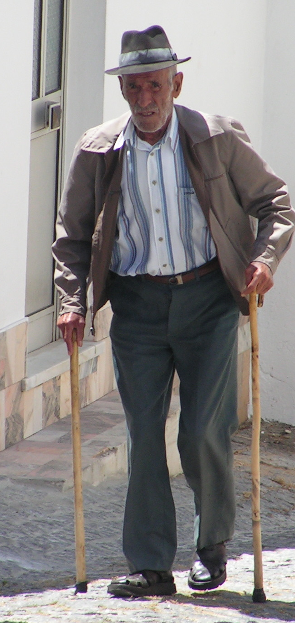
Completing item -1
Use of ‘too + adj/adv + to + verb + extension’.
The man is too___________.
old to walk
Complete the following sentences.
He is too dishonest to___________.
You are too short to_____________.
The girl was too silly ___________.
Note: Completed part must be underlined.
Notes:
too………… to (এত... যে)

Slide 8

Completing item -2
Use of ‘too + adj/adv + for + personal object + to + verb + extension’.
The tea is too hot for me__________.
to drink
Complete the following sentences.
The book is too hard for me to___________.
The path is too long for him to_____________.
The load is too heavy for them to___________.
Notes:
Too………… to (এত... যে)

Slide 9

Completing item -3
Use of ‘so………… that’.
She was so ill that_______________________.
she could not study at all
Formation: Given clause with so.. that + relevant sentence.
Notes:
So………… that (এত... যে)

Slide 10

Completing item -4
Use of ‘so/in order that’.
Formation: Given clause with so that/in order that + sub+
can/could/ may/might
+ verb +extension
Be prepared so that________________
He reads attentively so that________________________.
he can make a good result
Notes:
মনে রাখতে হবে so that এর পরে subject এর সাথে অবশ্যই tense অনুযায়ী can/ could/may/might/shall/should/must এ জাতীয় modal বসাতে হবে। So that/ in order that (যাতে)

Slide 11

Activities
The farmers sow good seeds so that ________________________________
He walked fast in order that_______________________________________
We eat vegetables so that__________________________________________
They play well in order that_______________________________________
He was so weak that______________________________________________

Slide 12


Completing item -5
Use of ‘provided/provided that/providing that
The plane will take off in time provided
weather is good.
Normally present indefinite tense is used
after provided/provided that/providing that
Formation:
Future indefinite tense + provided/provided
that/providing that + present indefinite tense

Slide 13
Activities
I will go to London provided that_______________________________________
They will play well provided that_______________________________________
I will take umbrella providing that______________________________________
He will wait for me provided___________________________________________
He will shine in life provided that______________________________________
Notes:
Evaluation/ Feed back

Slide 14
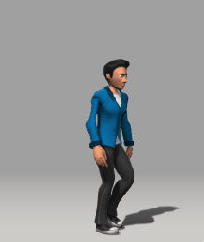
Completing item -6
Use of ‘lest’.
He walks fast lest_________________________.
he should/might reach in time
Structure: Assertive sentence + lest + subject + should/might + V₁ + extension.
Complete the sentences
He ran away fast lest _________________________
Read diligently lest___________________________
The thief ran quickly lest_______________________
Go sharp lest________________________________
He came to the station quickly lest_______________
Notes:
Lest (পিছে ভয় হয়)

Slide 15
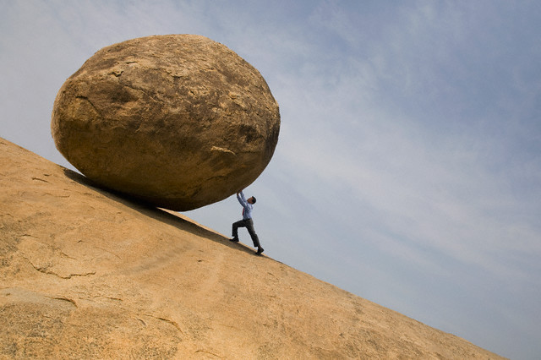
Completing item -7
Use of Unless
you will fail.
Unless you work hard, _____________
Complete the following sentences
Unless you read attentively,_________________
Unless you start at once,____________________
Come at 8 o’ clock unless___________________
He will not shine unless____________________
Unless you respect others,___________________
Notes:
Unless (যদি না)

Slide 16


Completing item -8
Use of Till/ Until
Formation: Given clause with till/until +An
affirmative sentence in present indefinite form
Wait until_______________
the rain stops.
Complete the sentences
1.Wait for me until________________
2. I will teach him till______________
3. He will nurse me until ___________
4. I will help him till ______________
5. Until I come___________________

Slide 17
Completing item -9
Use of As long as
Formation: Given clause with as long as +An affirmative sentence
Wait here as long as____________
I come back.
Complete the sentences
1. Allah will be with us as long as_________
2. He worked as long as ______________
3. Read as long as ___________
4. Help him as long as______________
5. I gave him as long as ___________________
Notes:
As long as (যে পর্যন্ত)

Slide 18
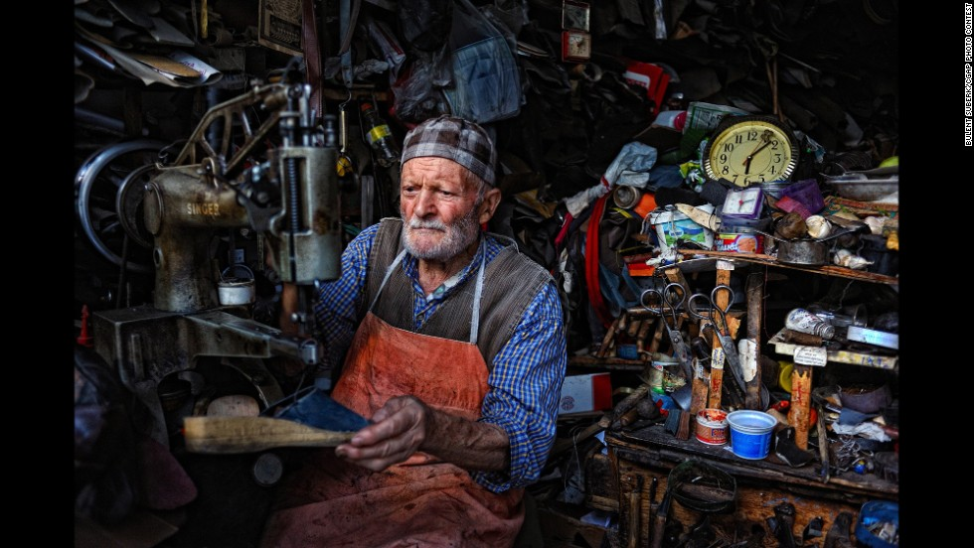
Completing item -10
Use of Though, although, since, as, because, if
Though he is poor,_____________
he is honest.
Since he is poor,_____________(complete the sentence)
He has to work hard because,_____________(Complete the sentence)
Formation : Given clause with though, although,
since, as, because, if + relevant sentence
Notes:
Actually they mean condition. The sentences are to be completed to full fill condition.

Slide 19
Completing item -11
Use of In spite of/despite
he is honest.
In spite of his poverty,___________
Formation: In spite of /Despite + possessive +
noun + relevant opposite meaning sentence.
Despite his good qualifications__________________________ (Complete it)
_________________________despite his innocence (Complete it)
In spite of trying hard ________________________________(complete it)
Notes:
In spite of/ despite ( সত্বেও)

Slide 20





Completing item -12
Use of In stead of/ In lieu of
In stead of history____________
he took logic.
in lieu of a pencil.
He bought a pen___ _____________
He ate fish __________________ (Complete it)
Notes:
In stead of/ In lieu of (পরিবর্তে)

Slide 21

Continue to next content
Notes:
Ending slide

